Slide 1
Gamification
Formed Fiction
Wai Fong, Wai Lok Cheng, Zachary Moore, Sung Su Park, Casey Riehle

Slide 2
What is Gamification?
Gaming elements in a non-game setting
E.g. applying for food worker’s card
Used to improve user engagement, learning, and more
Many educational games are to teach the players
Notes:
ryan

Slide 3
Our Goal
Design and implement a game which tests the following hypothesis:
A student playing a content-independent game outside of class with ties back to class will experience an increase in:
self reported motivation
participation in class
better grades
Acquire data on the gameplay and class work
Notes:
ryan

Slide 4
Requirements
Design a game which takes class based effort and produces rewards for the student
Require minimal effort from educators
Effort is based on attendance, assignment submissions, and lab work
Assignment submission and lab work is easy to check
Attendance is difficult to prevent cheating
Prevent overplay of the game
Notes:
Wai lok

Slide 5
Solution
Bonus codes are given during lectures
Utilize CSV files to distribute rewards for assignment submissions and lab work
Design the game to limit gameplay through use of stamina
The overall game is designed as an incremental style game
Naturally long gameplay
Provides rewards in limited increments
Contains minigames tailored to certain gamer types
Seeker (visual and story based)
Conqueror (satisfaction from challenge)
Mastermind (decision based thinking)
Notes:
Wai lok

Slide 6
Why A Game?
Several types of games were selected because they were the most popular subclasses of the BrainHex player satisfaction model
This allows for a wide audience that can enjoy one or more game types.
The fundamental aspect is to provide students with a reward for effort shown in classes.
Having an enjoyable reward can be a strong motivator.
A measured reward can be given based on class attendance/participation, and homework and lab submissions.
Notes:
Casey
Games are fun
7 branhex player types where one or more will hopefully appeal to any given student to allow for wide audience

Slide 7
How It Works
Instructors or TAs provide CSV files that are read and parsed to apply bonuses to students’ game account.
Students receive bonus code (for attendance and paying attention) and enter it in the game to receive an in-game bonus.
Research statistics will be saved and accessed by our project mentor for his research.
Statistics per student:
Amount of assignments turned in
Number of bonus codes entered
Time spent in each minigame
Progress in the game and minigames
Number of logins
Notes:
zach

Slide 8
Game overview
EECS
Server
(DB)
Incremental game
mini game2
mini game1
mini game3

Slide 9
Incremental
Type of games which provides long lasting gameplay and rewards in increments.
Rewards:
game coins that can be used in minigames
unlocking some special mode in minigames as player’s level increments
How to encourage students to play and attend class?
There are limitation
Time(playing time)- 1 hour per a week
Stamina(needed to play games) - 15 staminas per a week
They are given from attendance and homework submissions. (No class, No game)
Bonus code system
Bonus code can be found from the lecture slides or given by instructor.
Booster Item (Players can get more progress and coin in certain amount of time.)
Bonus stamina(+5)
Bonus play time(+10 minutes)

Slide 10
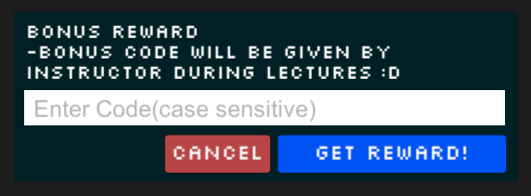
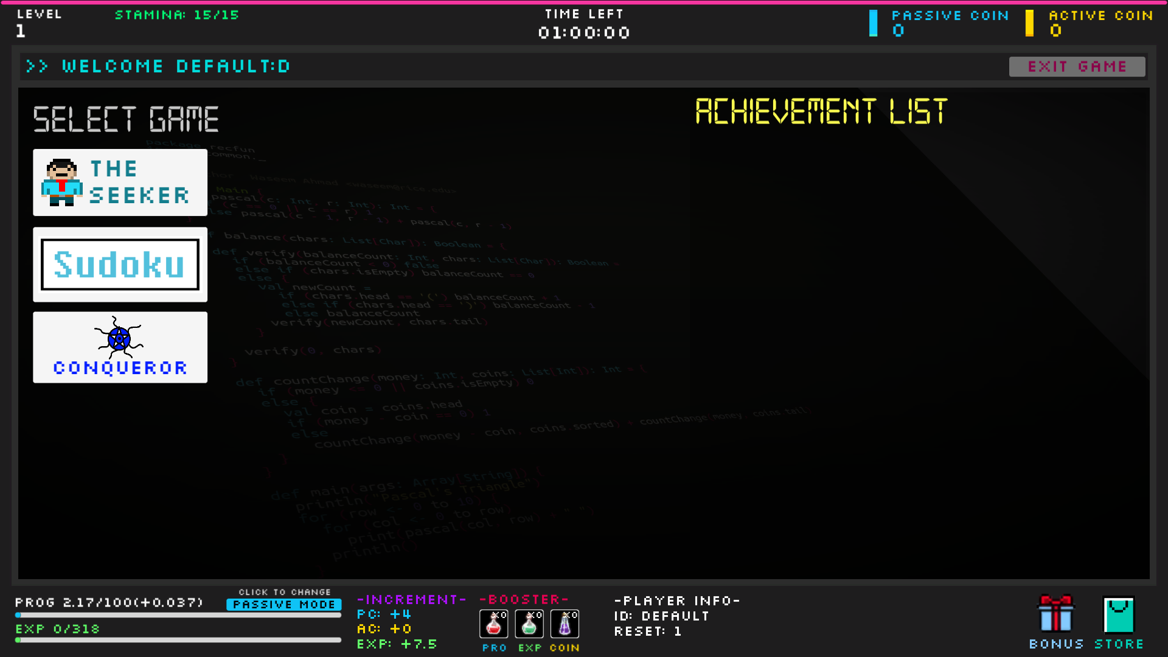
Incremental screenshot
Gamification Bonus code: (bonus time) A3F2dke

Slide 11
Game Types (mini games)
Seeker
Dungeon exploration
Conqueror
Top down shooter
Mastermind
Time based sudoku

Slide 12
Seeker
The seeker game starts off as a story based game
After clearing a certain portion of the game, the player can go through dungeons to find items
Uses stamina every time the player enters the dungeon or goes through the storyline
Items can be bought to further incremental progress such as coins and experience

Slide 13
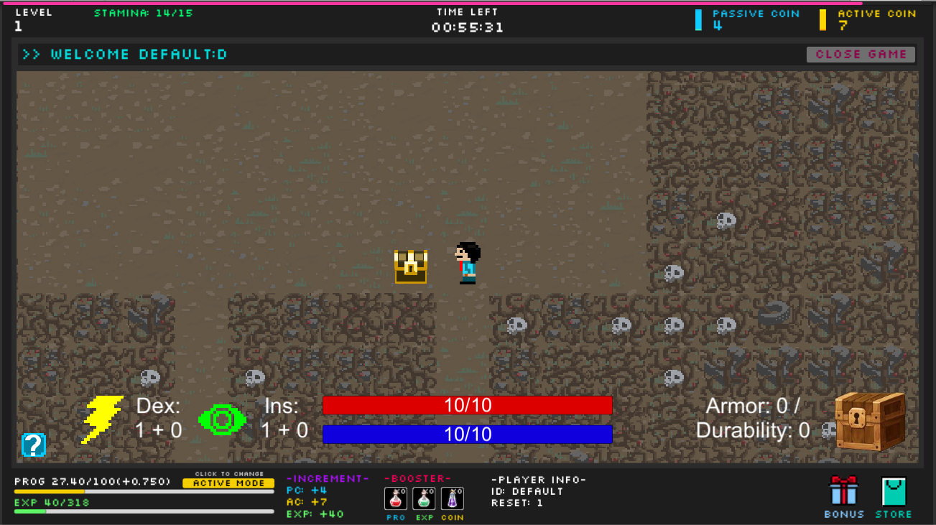
Seeker screenshot

Slide 14
Conqueror
Top down shooting game
Fight through waves of fast paced enemies that lead to a boss
Collect weapons to fight through more difficult enemies
Stamina is used when the player starts a new round
Incremental progress is awarded for picking up objects that are spawned in the game world.
Notes:
Casey

Slide 15
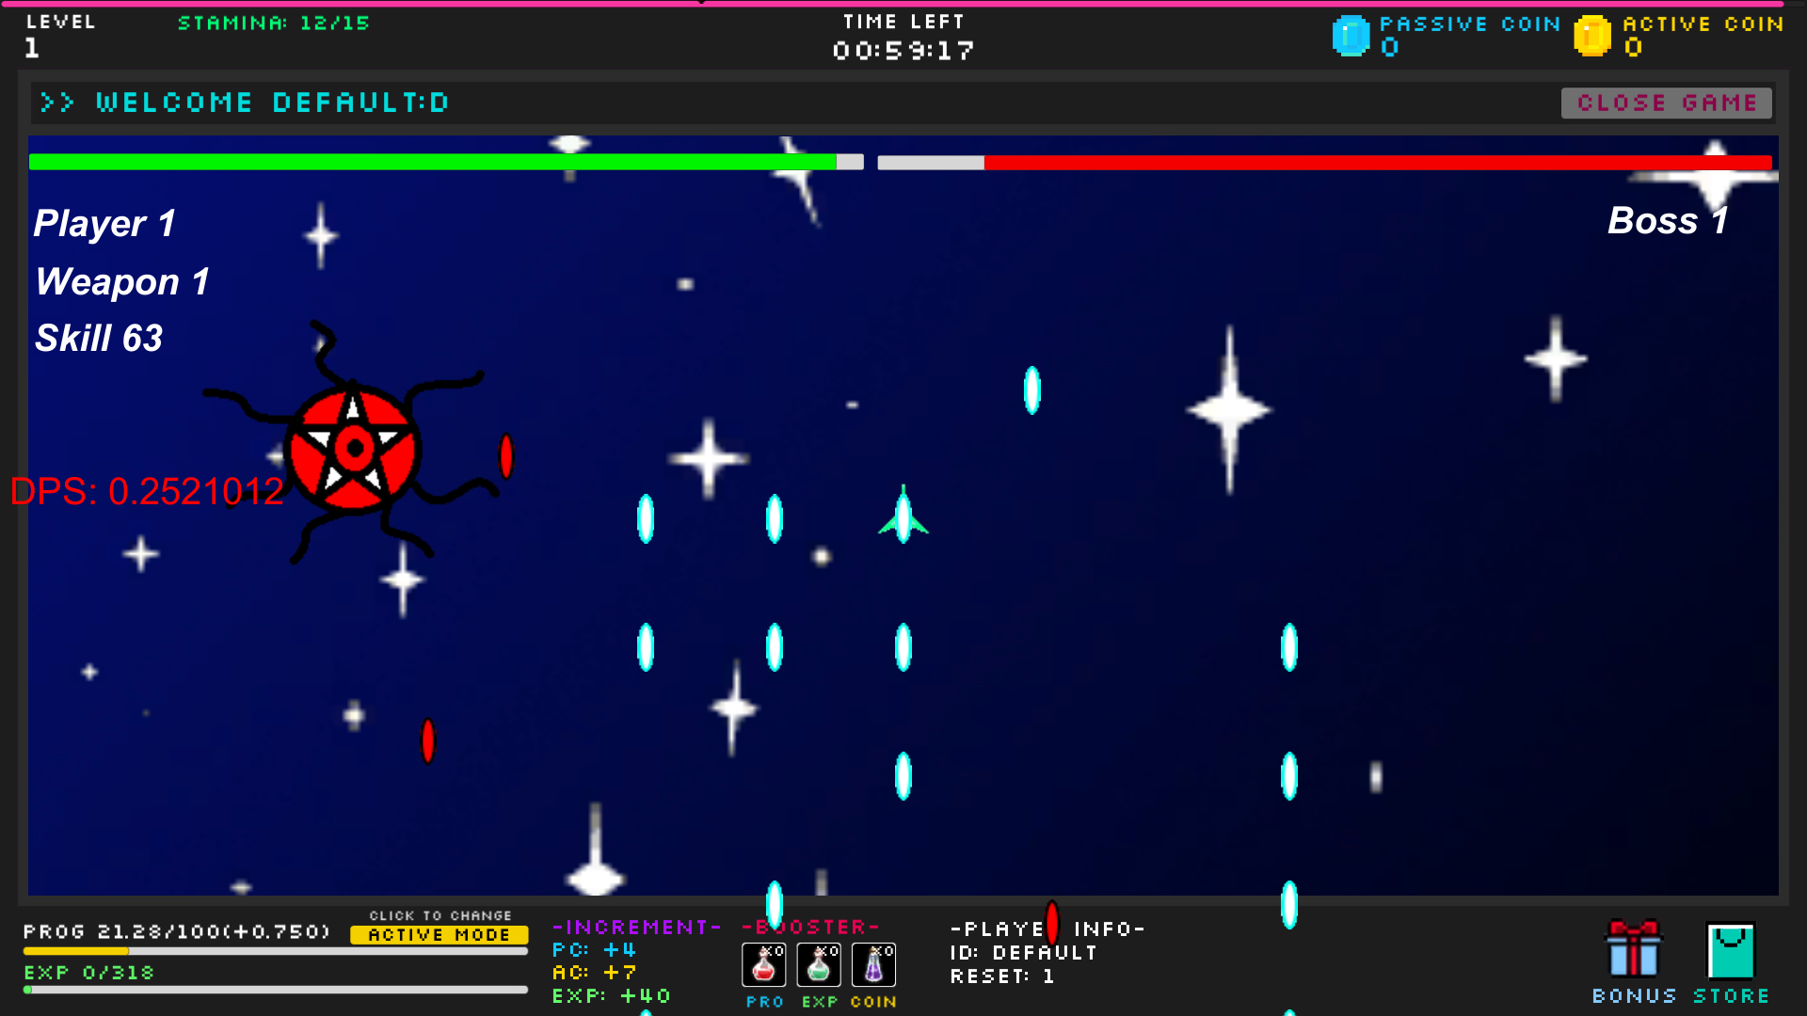
Conqueror screenshot

Slide 16
Mastermind
Sudoku is a popular game across the world, therefore most people would heard of it, or even played it before
Pros: Fun, quick to learn, great way to warm up your brain, different level of intensity
Cons: hard to master, hardest board can give people difficult time to complete
It is a 9x9 board game given a preset of numbers and empty spaces.
The goal is to fill all the empty spaces with numbers with the condition of no column, row or 3x3 block have the same numbers
Stamina is used every time the player starts a new board
The harder the board, the more incremental progress is rewarded

Slide 17
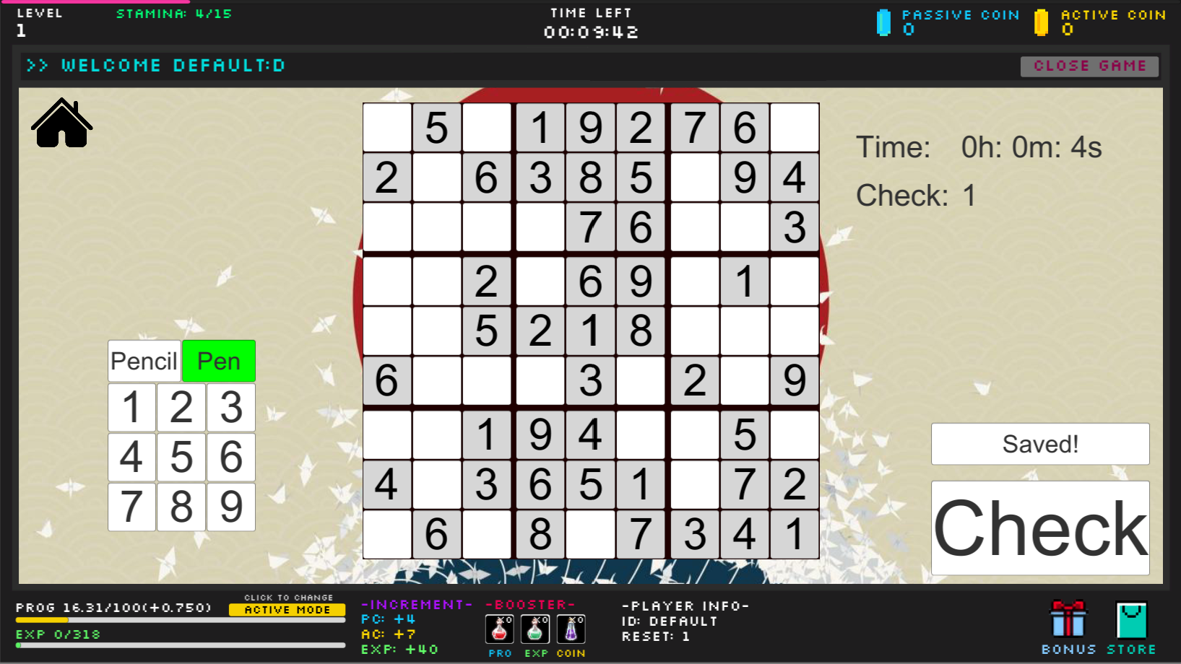
Mastermind screenshot

Slide 18
Questions?

